Slide 1




Domain-Driven Design: The Good Parts
Jimmy Bogard
@jbogard
github.com/jbogard
jimmybogard.com

Slide 2
Part 1: The Majestic Monolith

Slide 3

Project Background
Many counties and agencies pooling together
1st agile project for Texas government agency
1st DDD project for Texas government agency

Slide 4
Previous System(s)
Fort Worth
Dallas
Everyone Else
Houston
Austin
San Antonio

Slide 5
New System
Fort Worth
Everyone Else
Dallas
JCMS
Austin
San Antonio
Houston

Slide 6
Project Goals
Increase knowledge sharing
Comprehensive system covering all aspects of juvenile process
Complete picture of juvenile

Slide 7
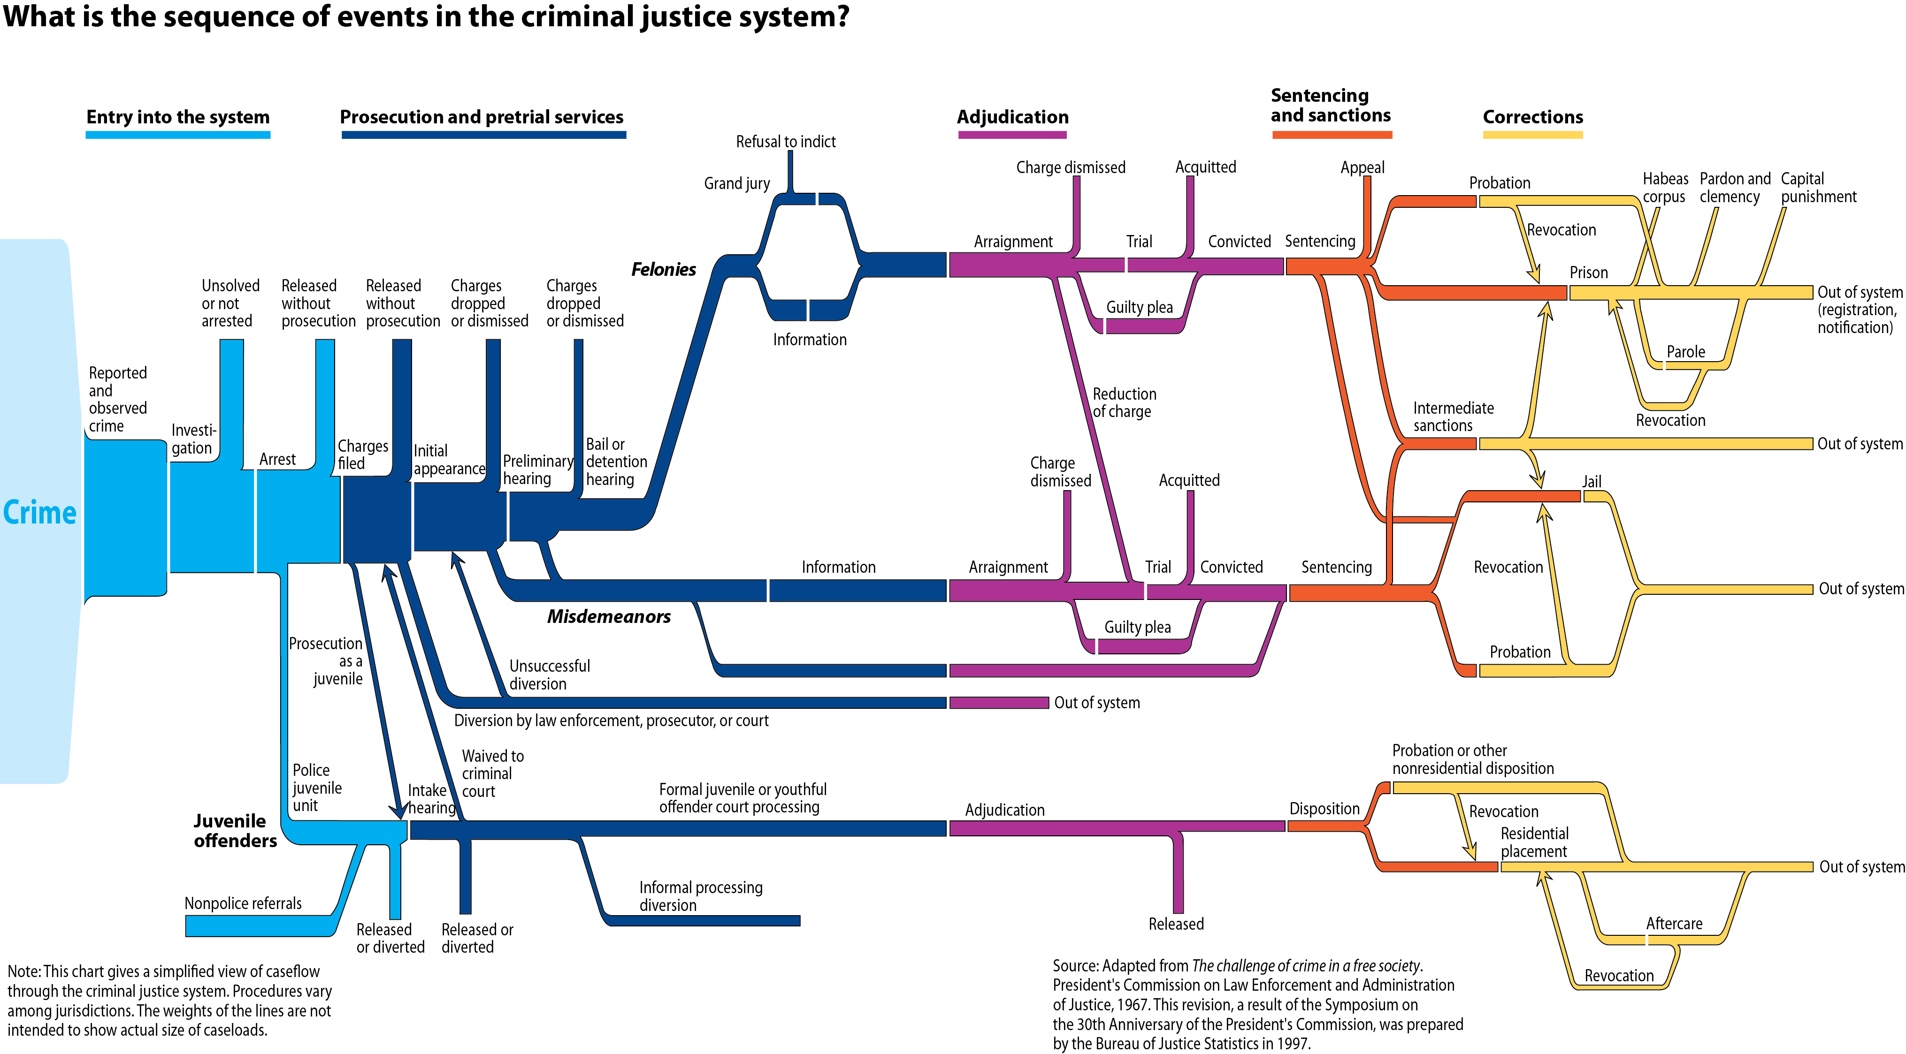

Slide 8
User Story and Personas
Pete Probation Officer
Percy Program Staff
Julie JPD Admin
Carl CRS Manager
Agnes Agency Admin
Samantha Substance Abuse
Larry Law Enforcement Officer
Nancy Nurse
Lucy LEA Approver
Ted Truancy Officer
Fred Fee Clerk
Patty Probation Officer with Disposition Priveleges
Dennis Detention Supervisor
Judy Judge
Ichibod Intake Supervisor
Curly Court Admin
Luann LEA Admin
Pam Prosecution Admin Clerk
Ivan Institutions Officer
Rose Records Management
Matt Mental Health
Andy Aftercare Officer
Andreas Auditor
Penny Chief Prosecutor

Slide 9
Cracks already showing: 72 personas
Pete Probation Officer
Percy Program Staff
Julie JPD Admin
Carl CRS Manager
Agnes Agency Admin
Samantha Substance Abuse
Pete Probation Officer
Percy Program Staff
Julie JPD Admin
Carl CRS Manager
Agnes Agency Admin
Samantha Substance Abuse
Larry Law Enforcement Officer
Nancy Nurse
Lucy LEA Approver
Ted Truancy Officer
Fred Fee Clerk
Patty Probation Officer with Disposition Priveleges
Larry Law Enforcement Officer
Nancy Nurse
Lucy LEA Approver
Ted Truancy Officer
Fred Fee Clerk
Patty Probation Officer with Disposition Priveleges
Dennis Detention Supervisor
Judy Judge
Ichibod Intake Supervisor
Curly Court Admin
Luann LEA Admin
Pam Prosecution Admin Clerk
Dennis Detention Supervisor
Judy Judge
Ichibod Intake Supervisor
Curly Court Admin
Luann LEA Admin
Pam Prosecution Admin Clerk
Ivan Institutions Officer
Rose Records Management
Matt Mental Health
Andy Aftercare Officer
Andreas Auditor
Penny Chief Prosecutor
Ivan Institutions Officer
Rose Records Management
Matt Mental Health
Andy Aftercare Officer
Andreas Auditor
Penny Chief Prosecutor
Pete Probation Officer
Percy Program Staff
Julie JPD Admin
Carl CRS Manager
Agnes Agency Admin
Samantha Substance Abuse
Pete Probation Officer
Percy Program Staff
Julie JPD Admin
Carl CRS Manager
Agnes Agency Admin
Samantha Substance Abuse
Larry Law Enforcement Officer
Nancy Nurse
Lucy LEA Approver
Ted Truancy Officer
Fred Fee Clerk
Patty Probation Officer with Disposition Priveleges
Larry Law Enforcement Officer
Nancy Nurse
Lucy LEA Approver
Ted Truancy Officer
Fred Fee Clerk
Patty Probation Officer with Disposition Priveleges
Dennis Detention Supervisor
Judy Judge
Ichibod Intake Supervisor
Curly Court Admin
Luann LEA Admin
Pam Prosecution Admin Clerk
Dennis Detention Supervisor
Judy Judge
Ichibod Intake Supervisor
Curly Court Admin
Luann LEA Admin
Pam Prosecution Admin Clerk
Ivan Institutions Officer
Rose Records Management
Matt Mental Health
Andy Aftercare Officer
Andreas Auditor
Penny Chief Prosecutor
Ivan Institutions Officer
Rose Records Management
Matt Mental Health
Andy Aftercare Officer
Andreas Auditor
Penny Chief Prosecutor

Slide 10
Color coded based on agencies
Pete Probation Officer
Percy Program Staff
Julie JPD Admin
Carl CRS Manager
Agnes Agency Admin
Samantha Substance Abuse
Larry Law Enforcement Officer
Nancy Nurse
Lucy LEA Approver
Ted Truancy Officer
Fred Fee Clerk
Patty Probation Officer with Disposition Priveleges
Dennis Detention Supervisor
Judy Judge
Ichibod Intake Supervisor
Curly Court Admin
Luann LEA Admin
Pam Prosecution Admin Clerk
Ivan Institutions Officer
Rose Records Management
Matt Mental Health
Andy Aftercare Officer
Andreas Auditor
Penny Chief Prosecutor

Slide 11
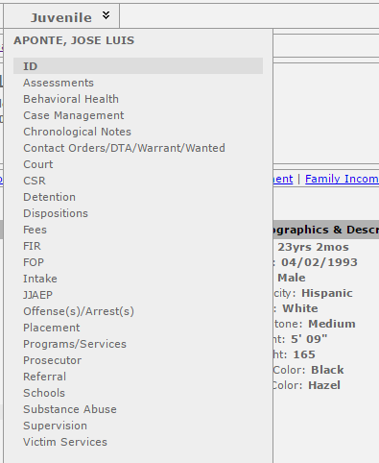
Lesson 1: Bounded contexts are a thing

Slide 12
Ambiguous Modeling
?
?
?
Person
?
?
?

Slide 13
Lesson 2: Ubiquitous Language should be ubiquitous

Slide 14
Competing Priorities
LEA
Prosecution
Offense/Arrest!
Case!
Trial!
Juvenile!
Courts
JPD

Slide 15
Lesson 3: Core Domain needs consensus

Slide 16
Competing Models
LEA
Prosecution
Form CR-23J
Something to charge for
Something to adjudicate
Something to move past
Courts
JPD

Slide 17
Lesson 4: Ubiquitous language needs consensus

Slide 18
Traditional n-tier
UI Layer
Business Logic Layer
Data Access Layer
Database

Slide 19
DDD-style n-tier
UI Layer
Domain Objects
Repository
Database

Slide 20
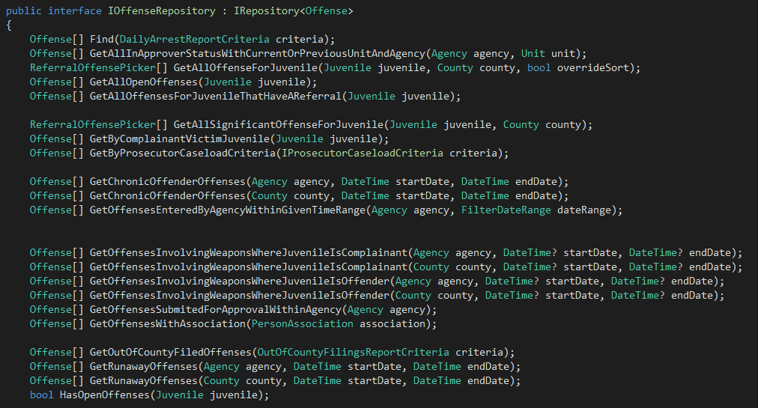
Pattern Happy

Slide 21
Lesson 5: Structural Patterns least important part of DDD
Also: Layers are for cakes

Slide 22
Final tally
195 controllers
652 actions
121 roles
218 entities
184 value objects
352 enumerations
~50 counties deployed

Slide 23

Majestic Monolith Myth

Slide 24
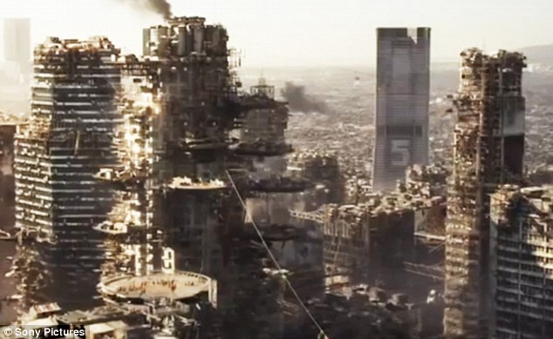
Reality

Slide 25
Part 2: The Do-over

Slide 26
Project Background
Too expensive/costly/risky to build single system
Focus one agency at a time
Start with prosecution

Slide 28
Built around bounded contexts
Prosecution

Slide 29
Built around bounded contexts
Prosecution
Cases

Slide 30
Built around bounded contexts
Prosecution
Cases
Dockets
Workflow
Grand Jury

Slide 31
Built around bounded contexts
Prosecution
Cases
Dockets
Workflow
Grand Jury

Slide 32
Built around bounded contexts
Prosecution
LEA
Cases
Dockets
Workflow
Grand Jury

Slide 33
Built around bounded contexts
Prosecution
LEA
Cases
Dockets
Defense
Workflow
Grand Jury

Slide 34
Built around bounded contexts
Prosecution
LEA
Cases
Dockets
Defense
Workflow
Grand Jury
Indigent Defense
Courts

Slide 35

Oh, that piece of ?

Slide 36
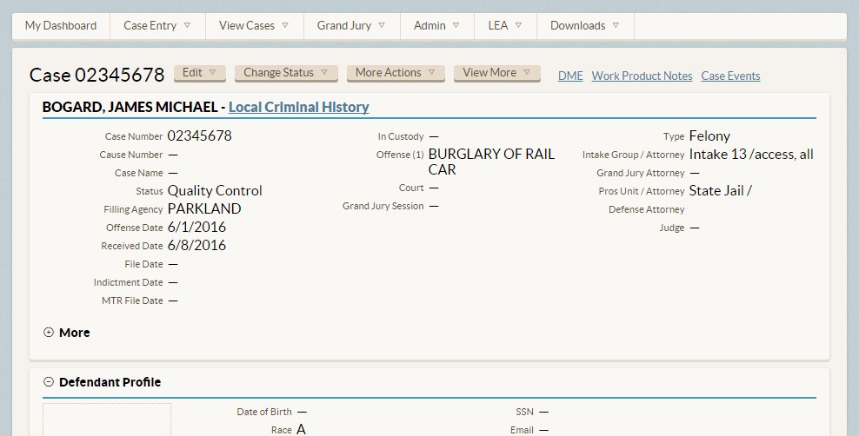
Building case-centric system

Slide 37
Lesson 1: Cohesiveness brings clarity and deeper insight

Slide 38
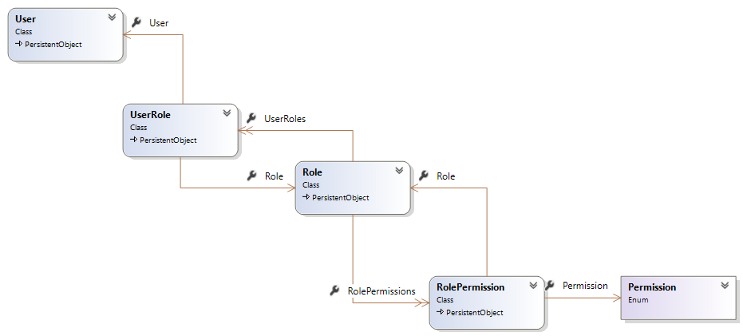
Modeling Roles and Security

Slide 39
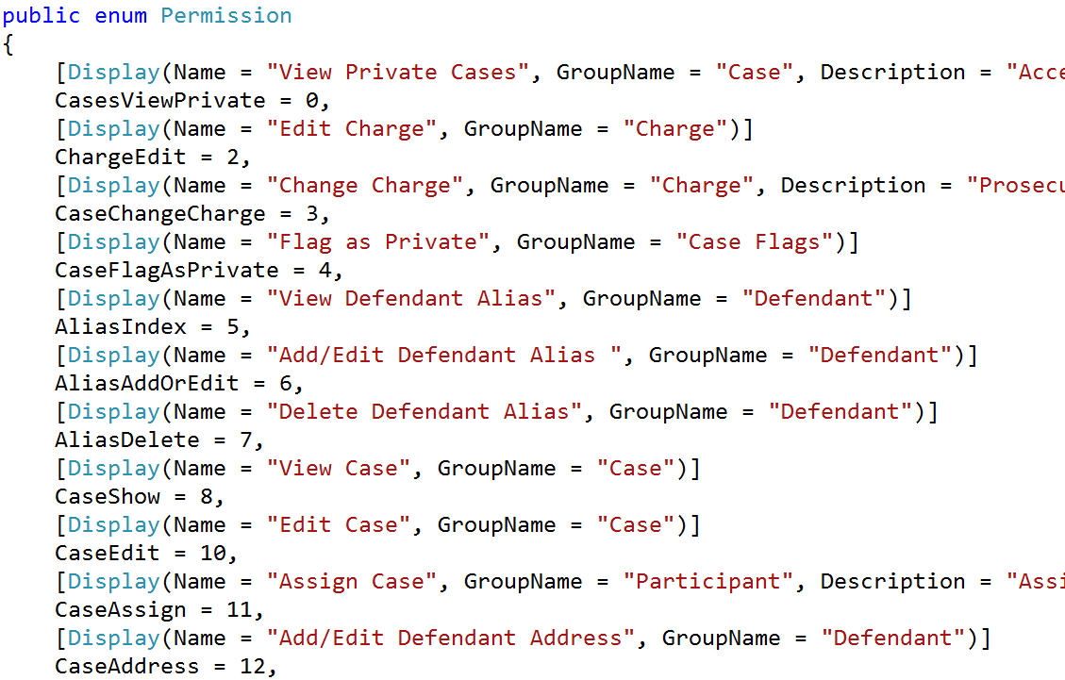
Granular, task-based permissions

Slide 40
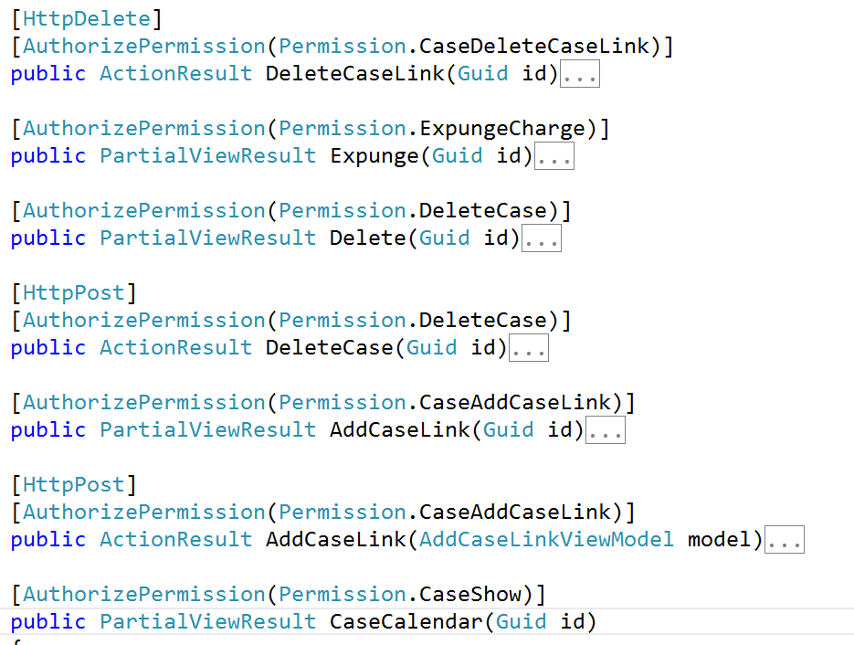
Associating permissions

Slide 41
Lesson 2: Flexible in places, rigid in others

Slide 42
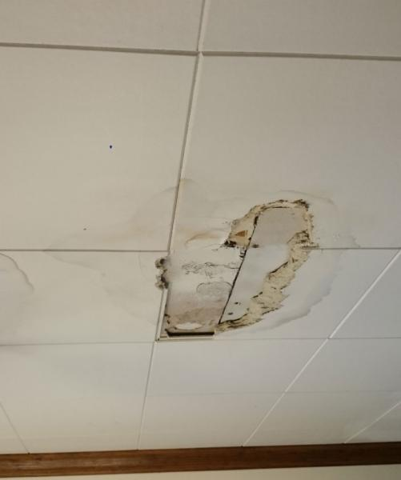

The File Management Problem

Slide 43
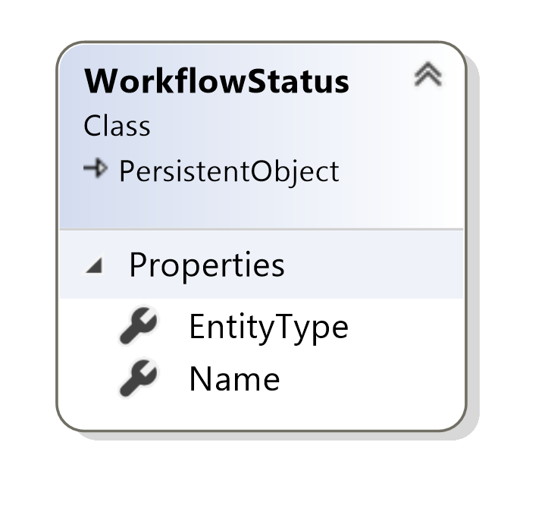
Modeling Flexible Workflows

Slide 44
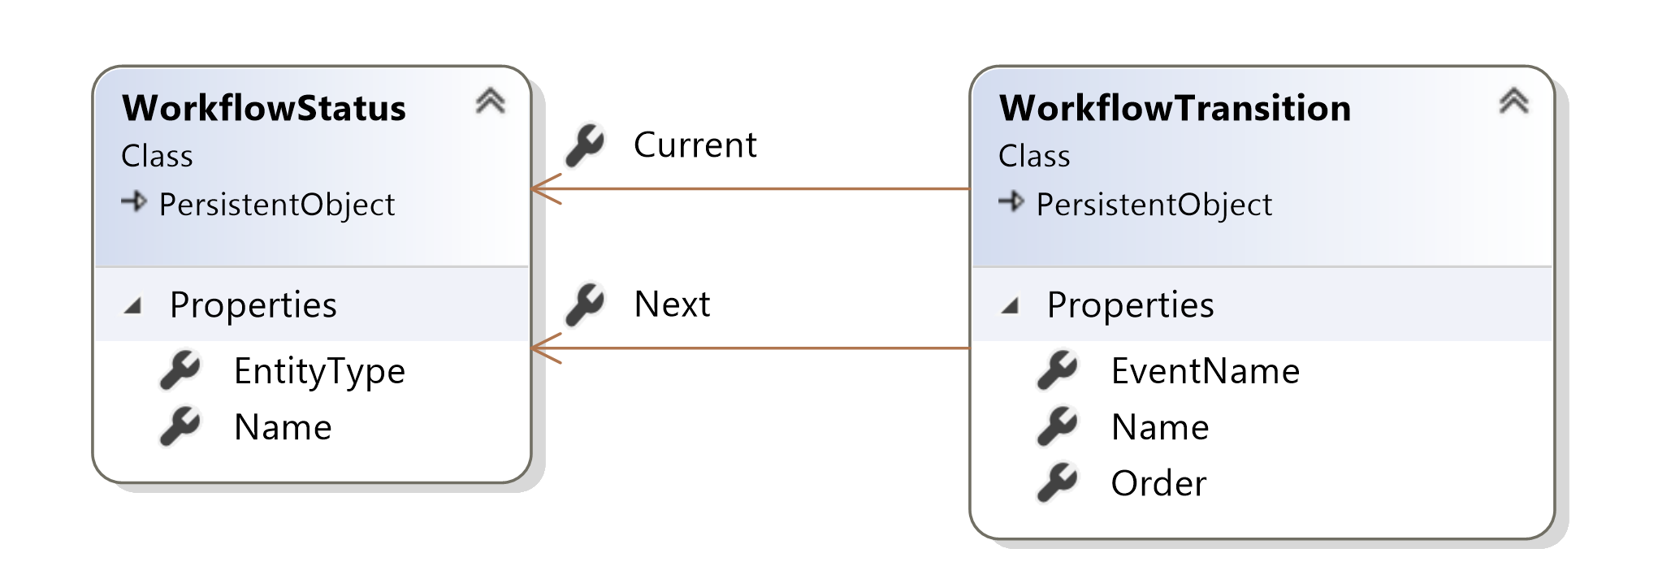
Modeling Flexible Workflows

Slide 45
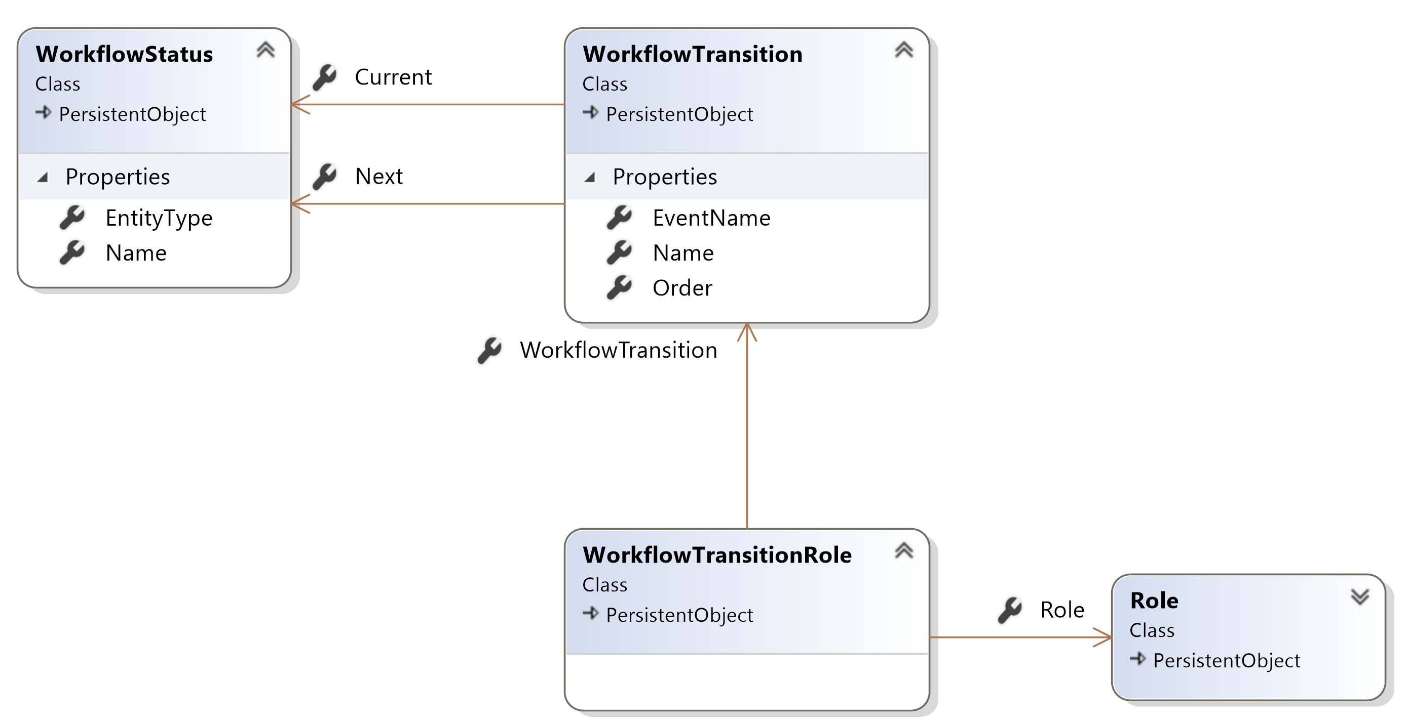
Modeling Flexible Workflows

Slide 46
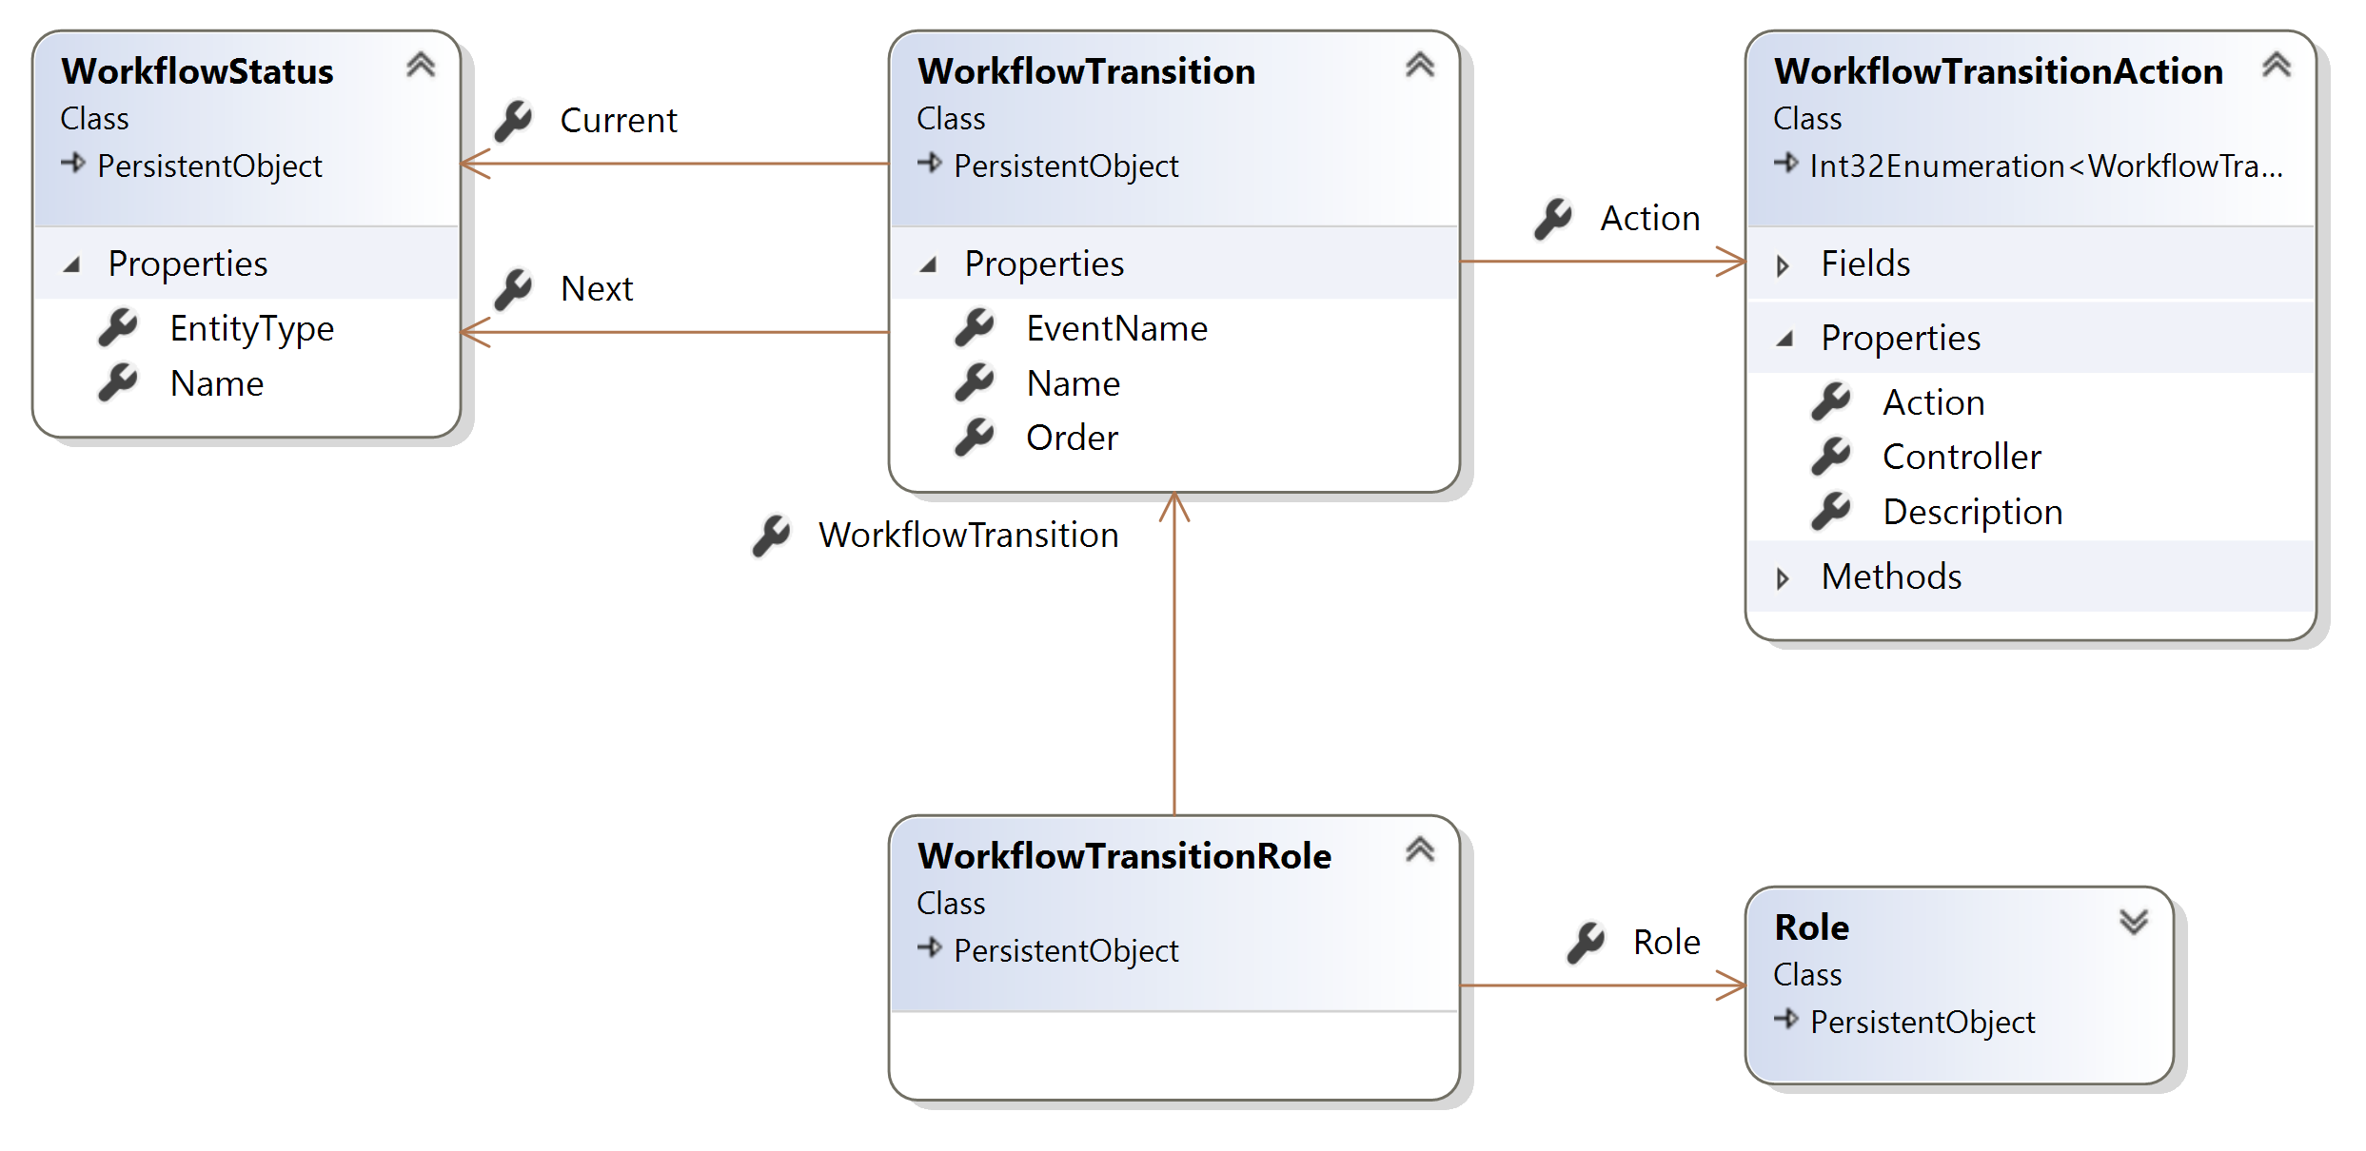
Modeling Flexible Workflows

Slide 47
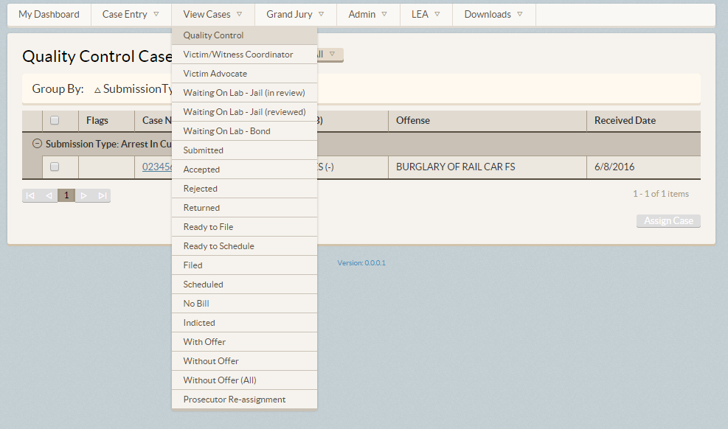
Driving work via queues

Slide 48
Lesson 3: Sometimes the model is a step up from the model

Slide 49
First step to sanity: Collapse layers

Slide 50
Web App Characteristics
Web App
Safe
Idempotent
Unsafe
Not idempotent
GET
Query
POST
Command

Slide 51
Modeling requests
Input
Request Handler
Output

Slide 52

Modeling requests with MediatR
Command
Command
Handler
Query
Query Handler

Slide 53
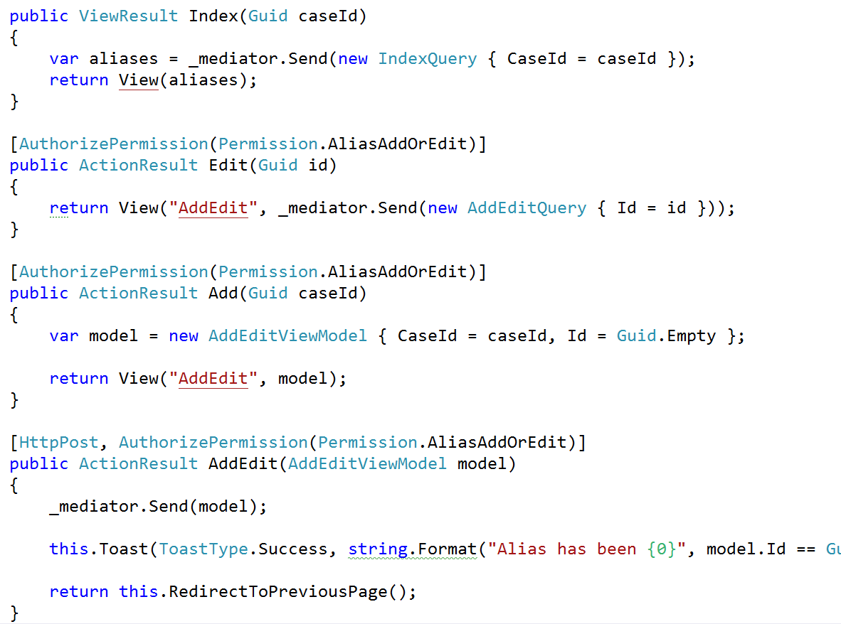
Ditching patterns

Slide 54
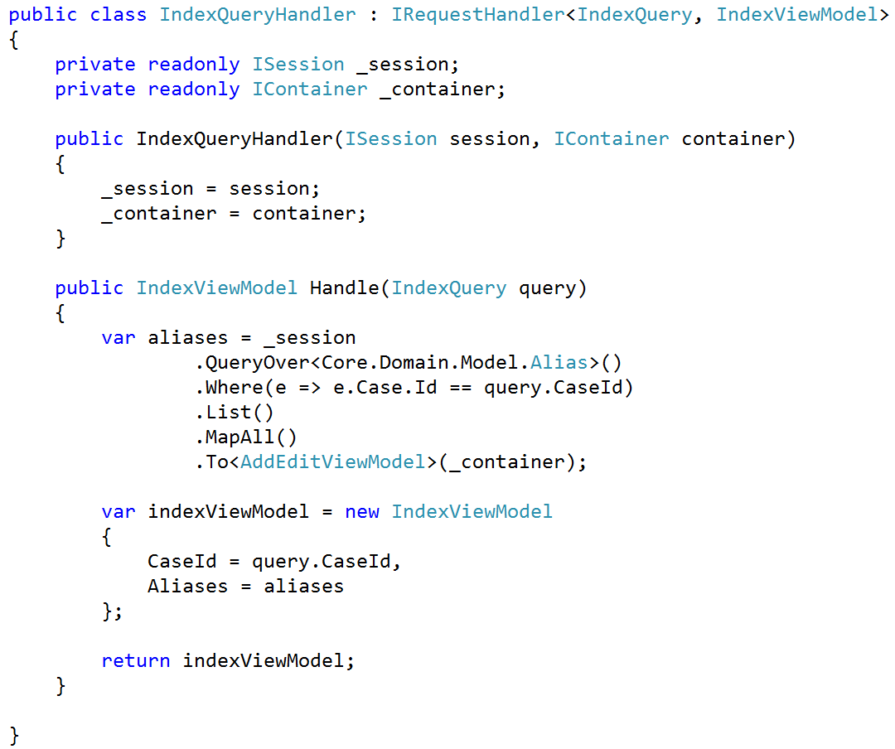
Ditching abstractions

Slide 55
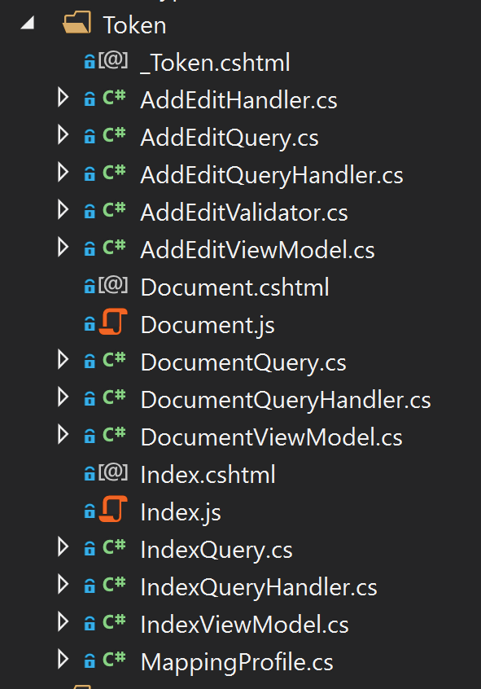
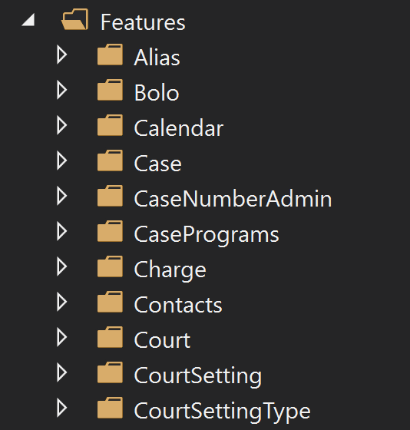
Organize by feature

Slide 56
Lesson 4: Don’t blindly follow pattern advice
But CQRS is lovely

Slide 57
Dealing with others
Prosecution
Cases
Dockets
Workflow
Grand Jury

Slide 58
Dealing with others
Prosecution
LEA
Cases
Dockets
Workflow
Grand Jury

Slide 59
Dealing with others
Prosecution
LEA
LEA Portal
Cases
Dockets
Workflow
Grand Jury

Slide 60
Dealing with others
Defense
Prosecution
LEA
LEA Portal
Cases
Dockets
Workflow
Grand Jury

Slide 61
Dealing with others
Defense
Prosecution
Portal
LEA
LEA Portal
Cases
Dockets
Workflow
Grand Jury

Slide 62
Dealing with others
Defense
Prosecution
Portal
LEA
LEA Portal
Cases
Defense API
Dockets
Workflow
Grand Jury

Slide 63
Dealing with others
Defense
Prosecution
Portal
LEA
LEA Portal
Cases
Defense API
Dockets
Workflow
Grand Jury
Indigent Defense

Slide 64
Dealing with others
Defense
Prosecution
Portal
LEA
LEA Portal
Cases
Defense API
Dockets
Workflow
Grand Jury
Courts
Indigent Defense

Slide 65
Lesson 5: Microservices and anti-corruption layers are your friend

Slide 66
Final tally
70 controllers
600 actions
239 permissions
139 entities
0 value objects (they’re not a thing in SQL)
80 enumerations
~30 counties deployed

Slide 67
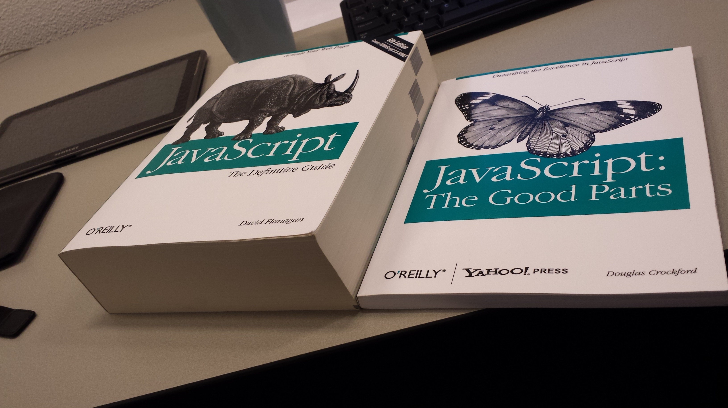

Slide 68
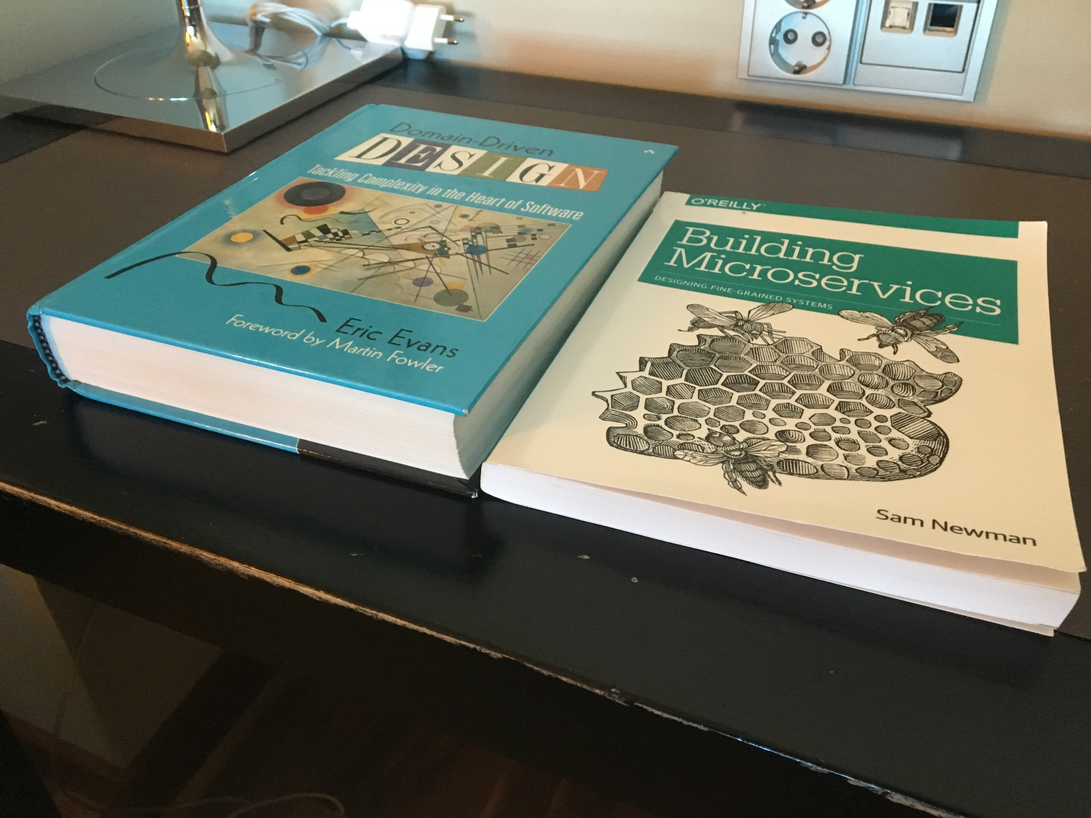

Slide 69
Domain-Driven Design: The Good Parts
Jimmy Bogard
@jbogard
github.com/jbogard
jimmybogard.com

